Slide 1
Homoplasy And Homology In
Creatures With Prehensile Tales
By Paul Nethercott
January 2014
www.creation.com

Slide 2
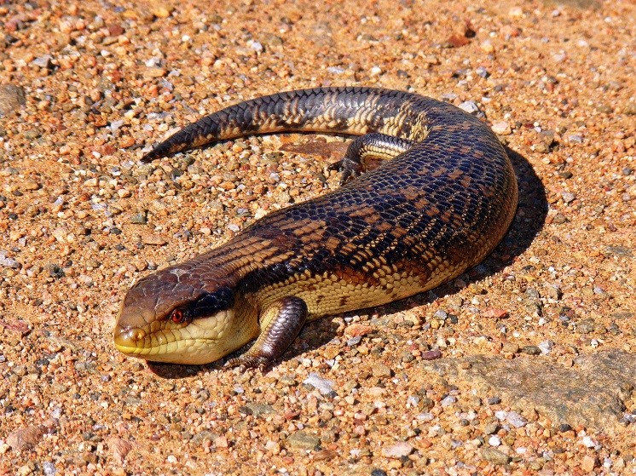
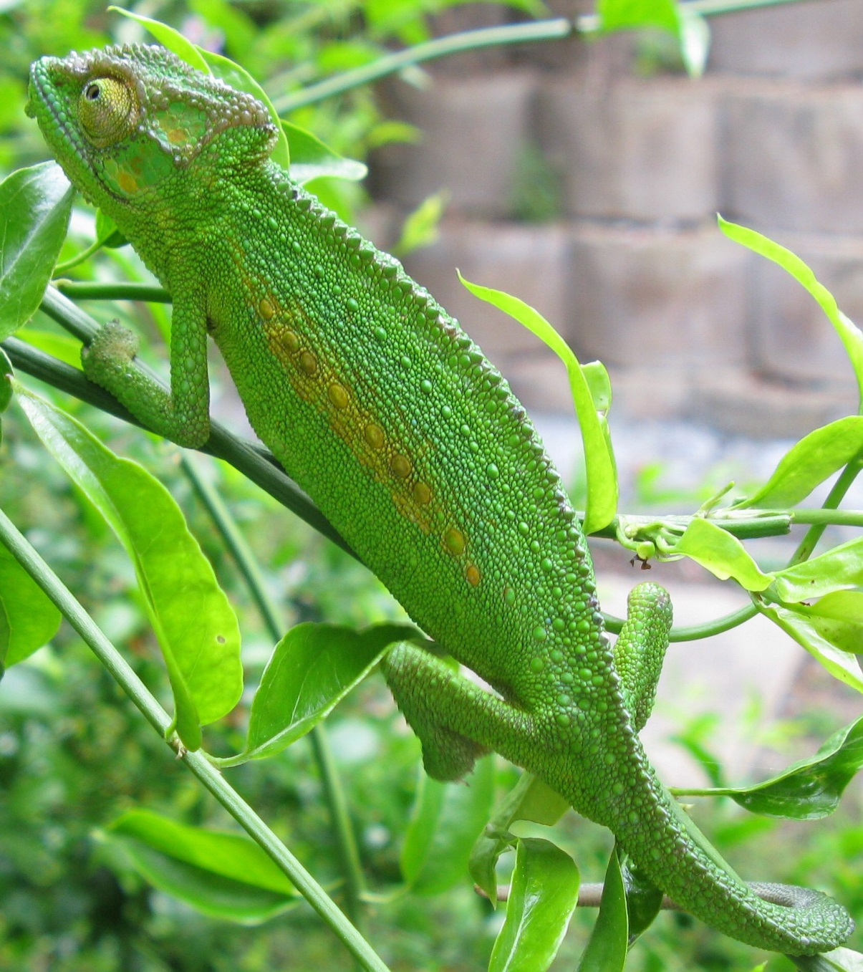
Blue Tongued Skink
Chameleon
http://www.wikipedia.org

Slide 3
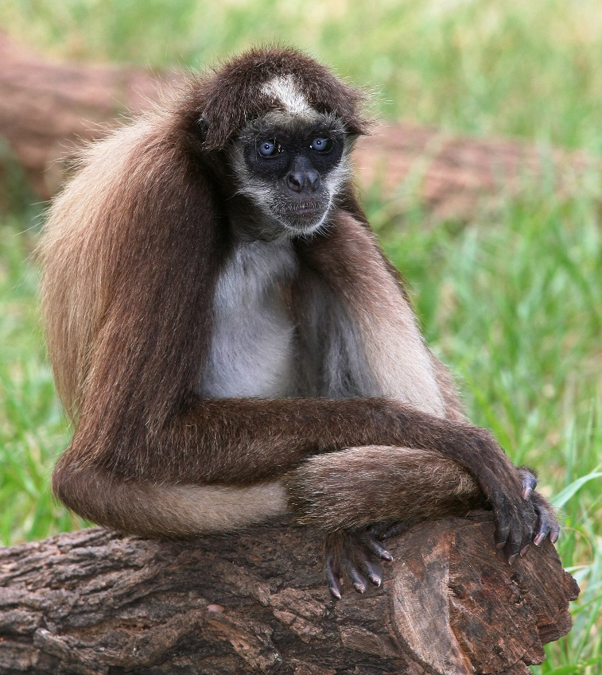
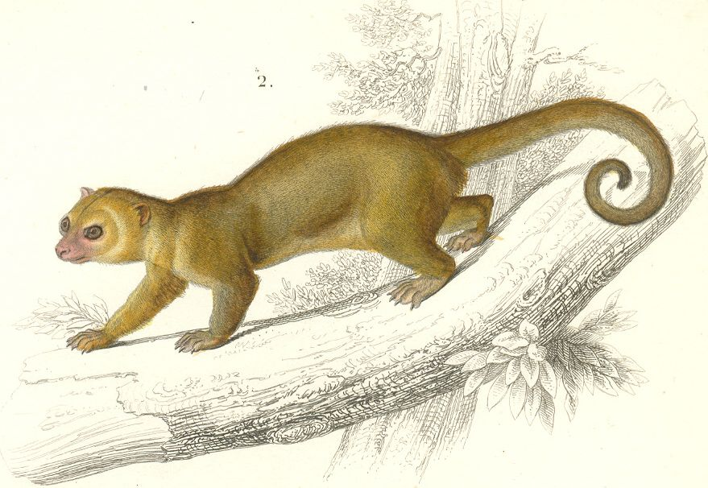
American Monkeys
Brazilian Kinkajou

Slide 4
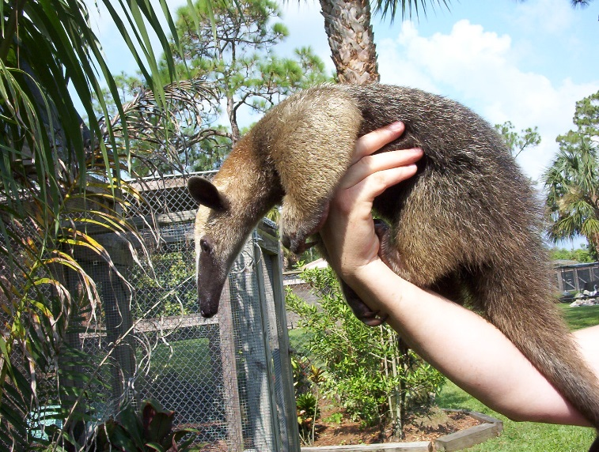
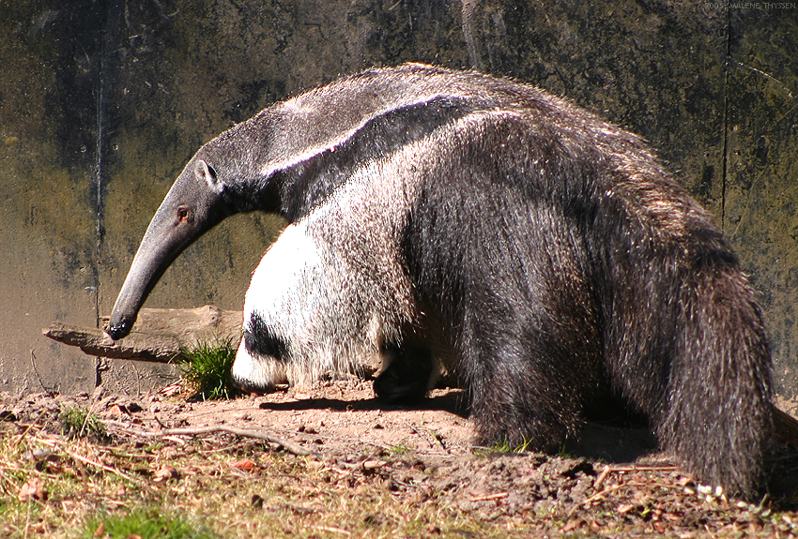
Lesser Anteater
Mexican Anteater

Slide 5
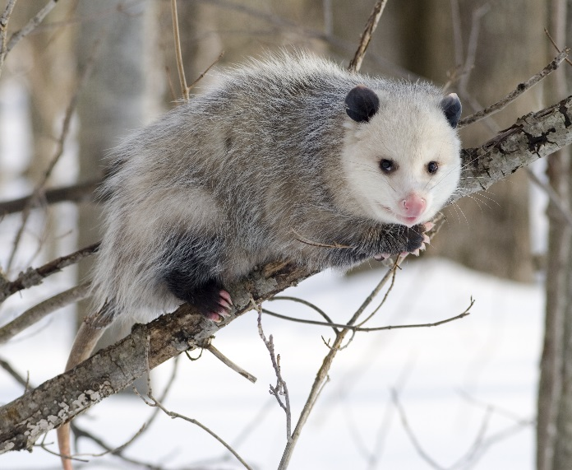
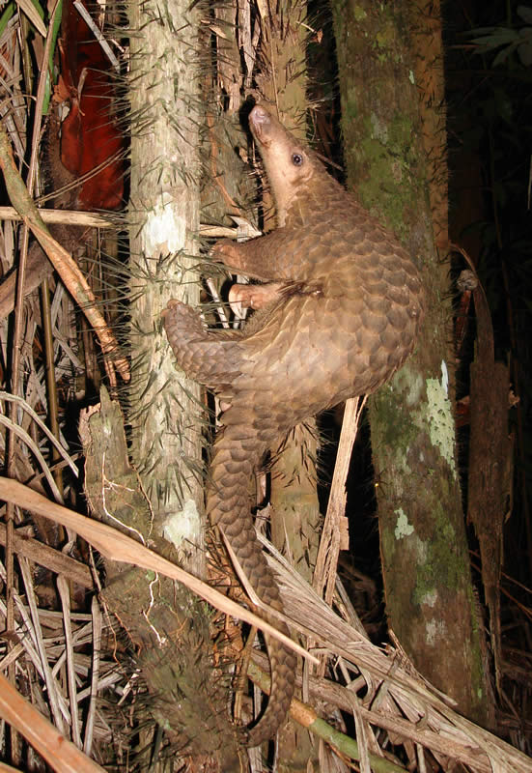
American Opossum
Indonesian Pangolin

Slide 6
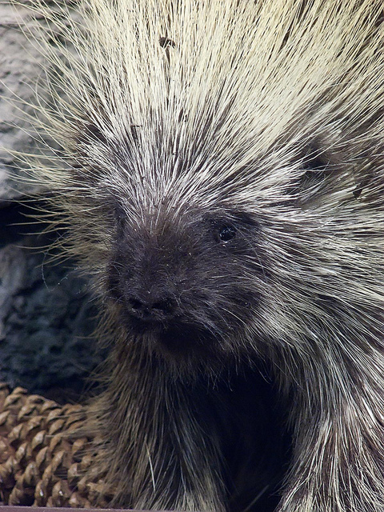
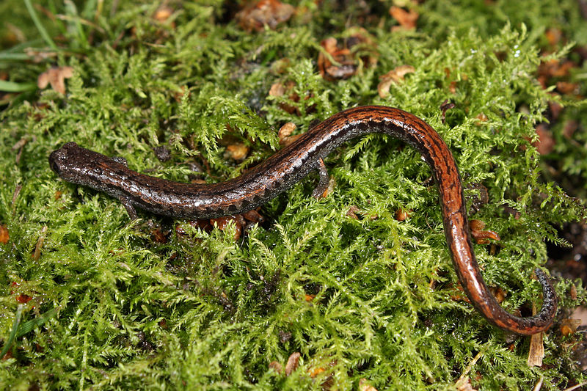
American Porcupine
The Salamander Bolitoglossa

