Slide 1
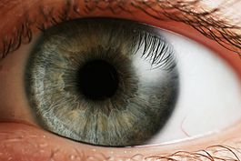
Eye Phylogenies
By Paul Nethercott
August 2014
www.CreationismOnline.com
www.wikipedia.com

Slide 2
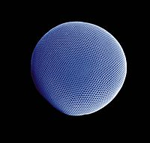
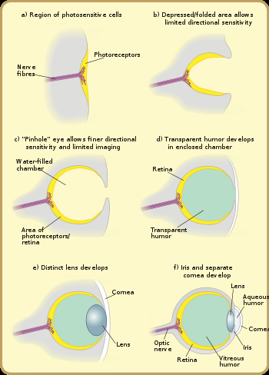
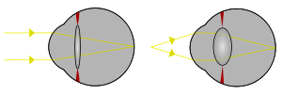
The Evolution Of The Eye

Slide 3
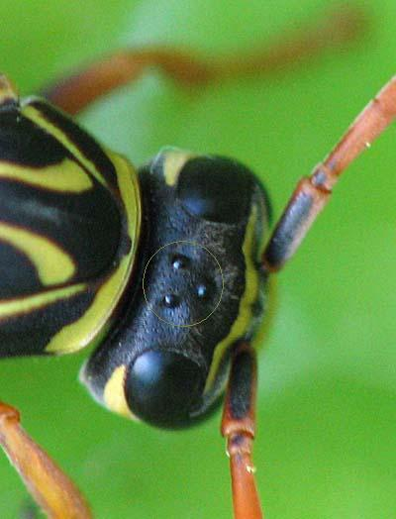
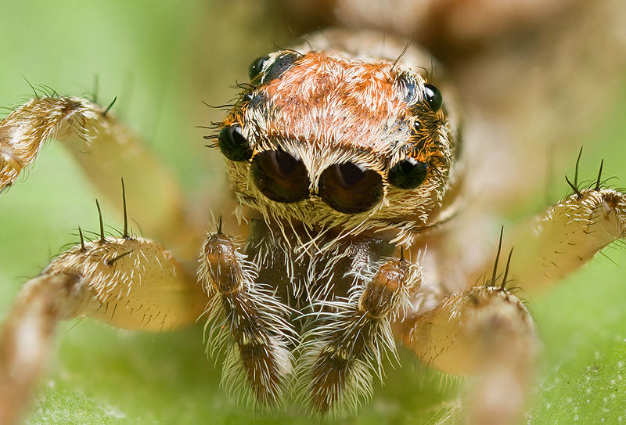
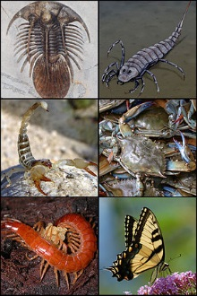
Pit eyes, also known as stemma

Slide 4
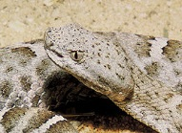
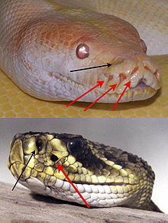
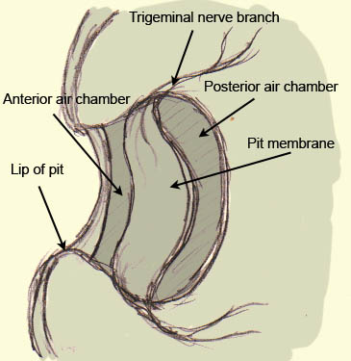
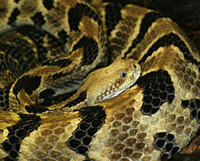
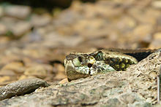
Infrared Sensing in Snakes
Ridge-Nosed Rattlesnake
Diagram of the Crotaline pit organ.
Timber Rattlesnake

Slide 5
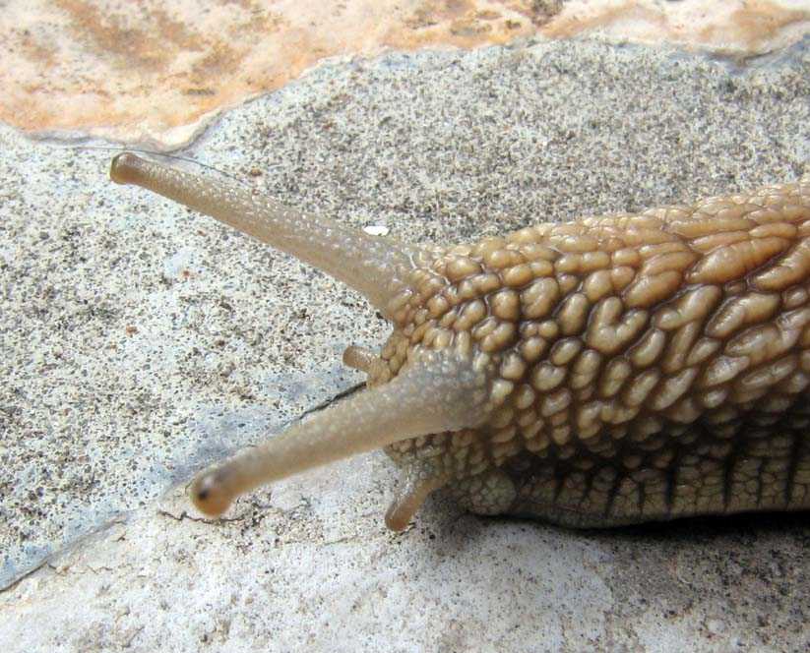
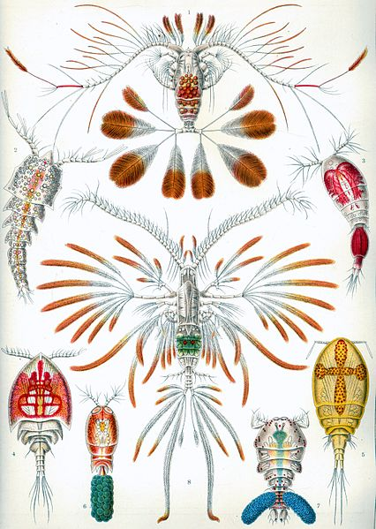
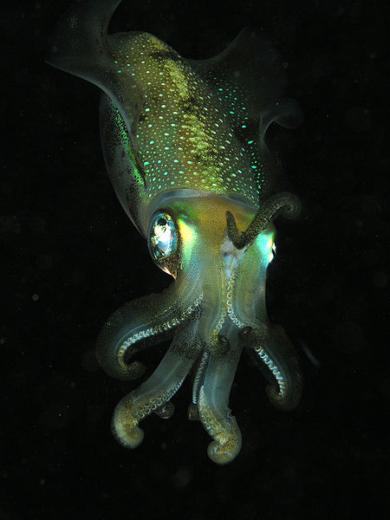
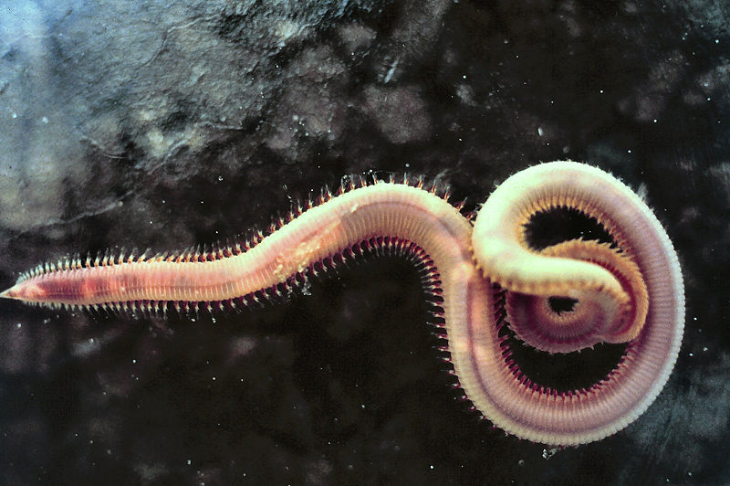
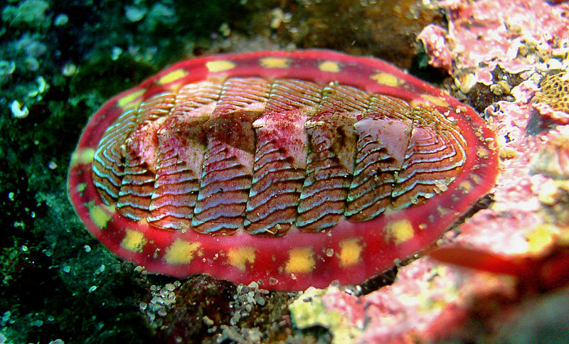
The Spherical Lensed Eye
Heterogeneous eyes have evolved at least nine times: four or more times in gastropods, once in the copepods, once in the annelids, once in the cephalopods, and once in the chitons, which have aragonite lenses.
Gastropods
Copepods
Cephalopods
Annelids
Chitons

Slide 6
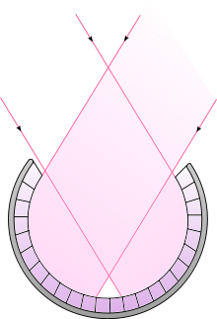
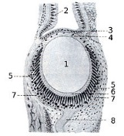
The Spherical Lensed Eye
In gastropods.
Gastropods
Drawing of cross section of the eye of Helix pomatia. 1 - lens 2 - olfactory epithelium 3 - corneal epithelium 4 - corneal endothelium 5 - retina 6 - layer with rod cells 7 - fibrous connective tissue layer 8 - nerve of the eye

Slide 7
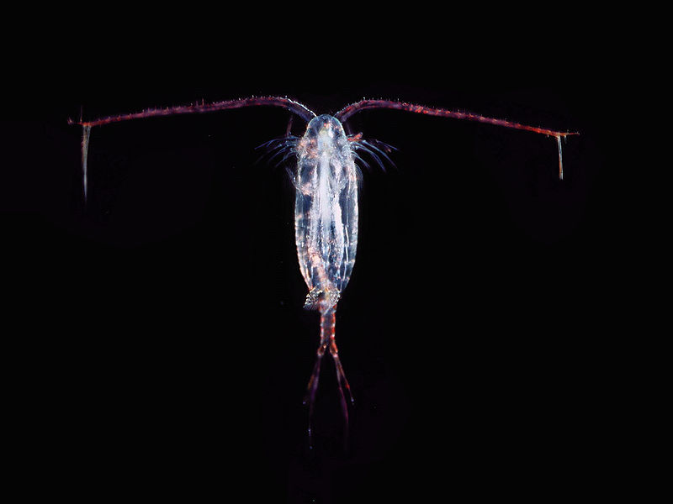
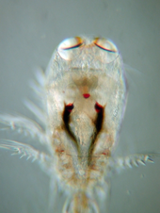
Most copepods have a single compound eye in the middle of their head

Slide 8
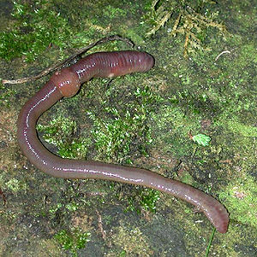
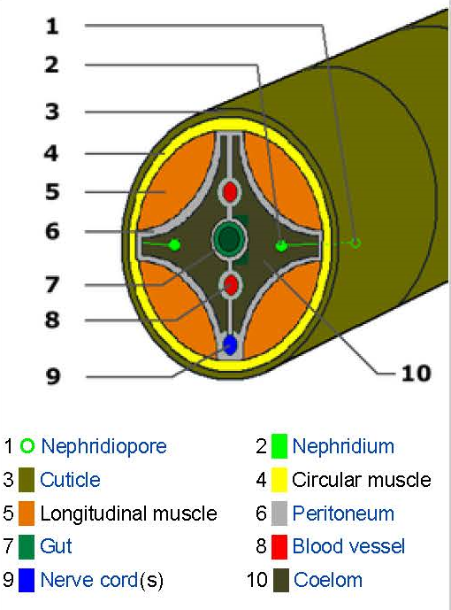
Annelids
The annelids (also called "tape worms"), formally called Annelida (from Latin anellus "little ring"), are a large phylum of segmented worms

Slide 9
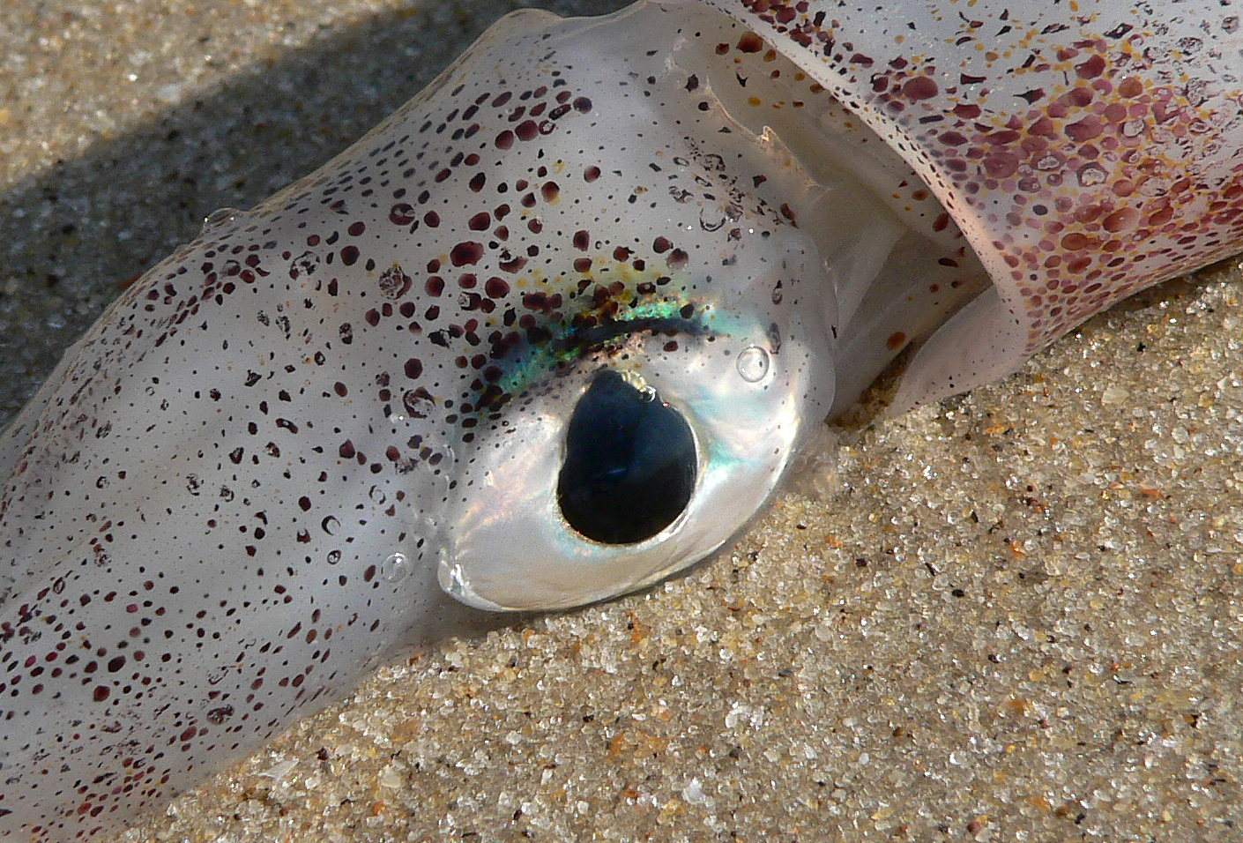
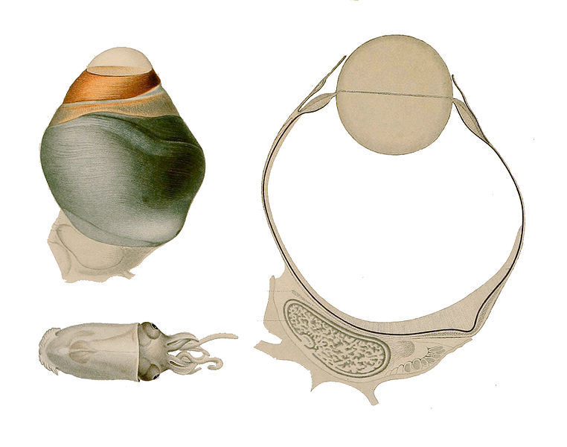
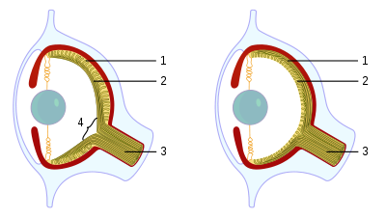
Cephalopods (octopuses, squid, and cuttlefish)
Squid Eye
The Squid Eye
Human Eye [Left] And Squid Eye [Right]

Slide 10
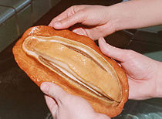
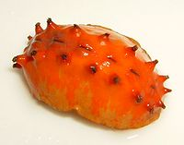
Chitons
The primary sense organs of chitons are the subradula organ and a large number of unique organs called aesthetes.
The aesthetes consist of light-sensitive cells just below the surface of the shell, although they are not capable of true vision. In some cases, however, they are modified to form ocelli, with a cluster of individual photoreceptor cells lying beneath a small lens, in some cases made up of aragonite. An individual chiton may have thousands of such ocelli.
These 'rock-based-eyes' make them capable of true vision, though research continues as to the extent of their visual acuity it is known that they can differentiate between a predator's shadow and changes in light caused by clouds.

Slide 11
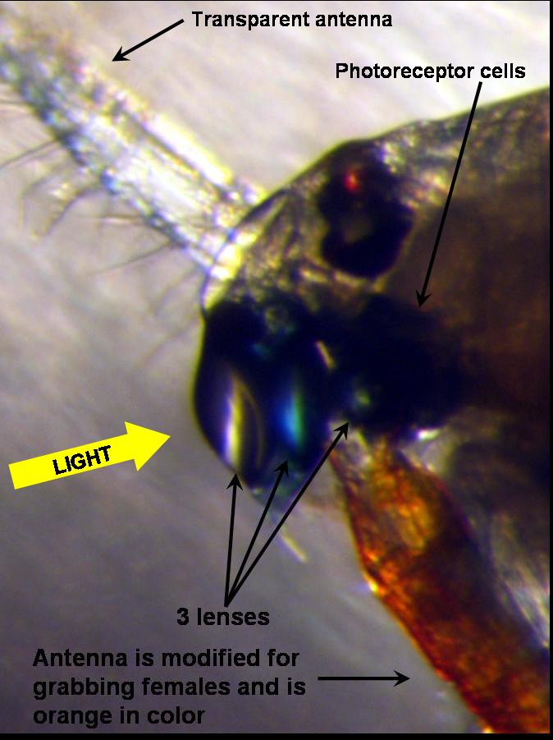
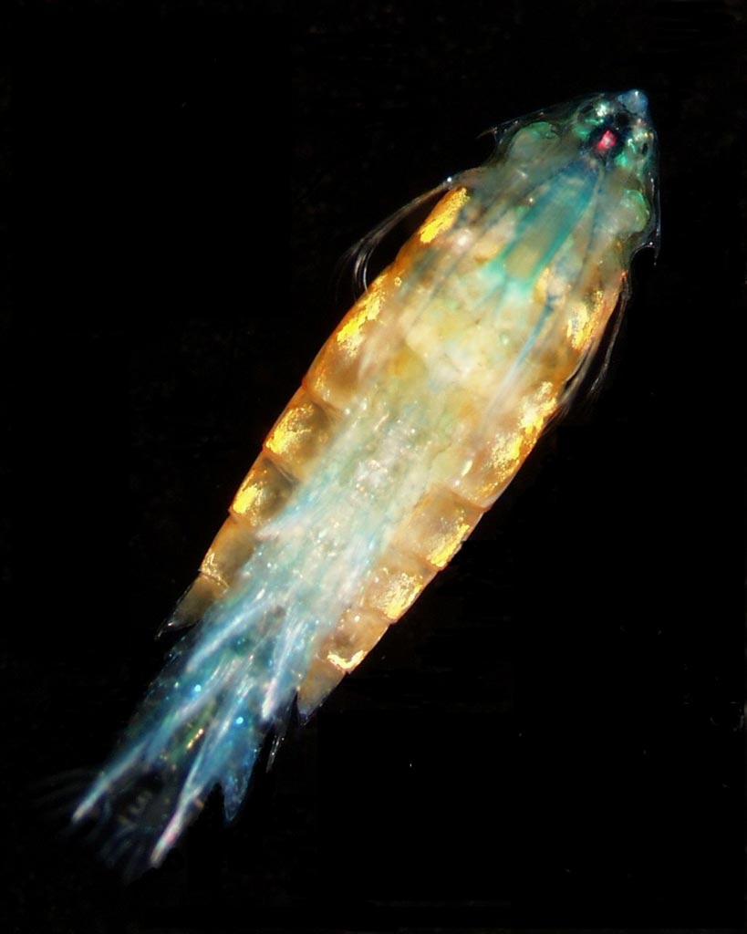
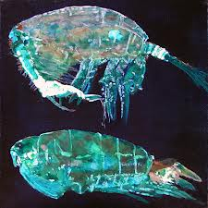
The Copepod Pontella, Multiple Lenses

Slide 12
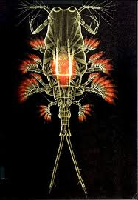
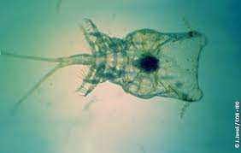
The Copepod Copilia, Multiple Lenses

Slide 13
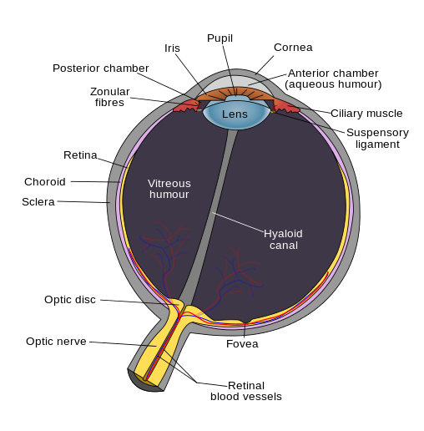
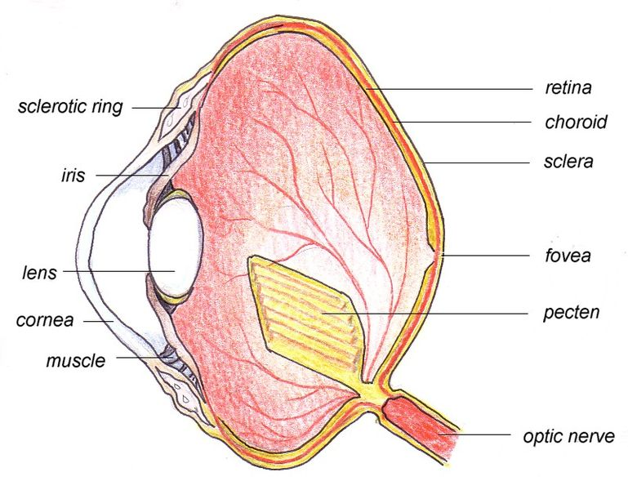
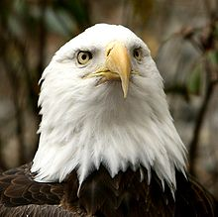
Refractive Cornea
Human Eye
Birds Eye

Slide 14
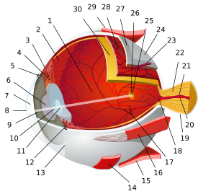
The Human Eye
Posterior segment
Ora serrata
Ciliary muscle
Ciliary zonules
Schlemm's canal
Pupil
Anterior chamber
Cornea
Iris
Lens cortex
Lens nucleus
Ciliary process
Conjunctiva
Inferior oblique muscule
Inferior rectus muscule
16. medial rectus muscle
17. retinal arteries and veins
18. Optic disc
19. Dura mater
20. Central retinal artery
21. Central retinal vein
22. Optic nerve
23. Vorticose vein
24. Bulbar sheath
25. Macula
26. Fovea
27. Sclera
28. Choroid
29. Superior rectus muscule
30. Retina

Slide 15
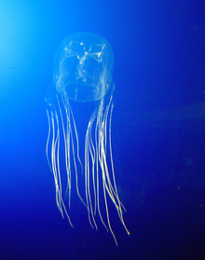
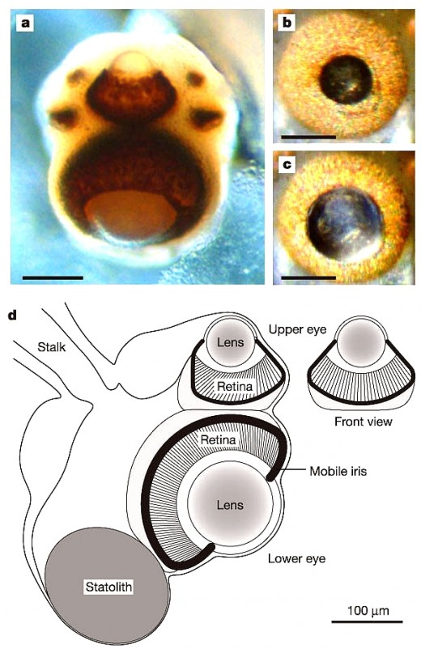
Refractive Cornea
The Box Jelly Fish

Slide 16
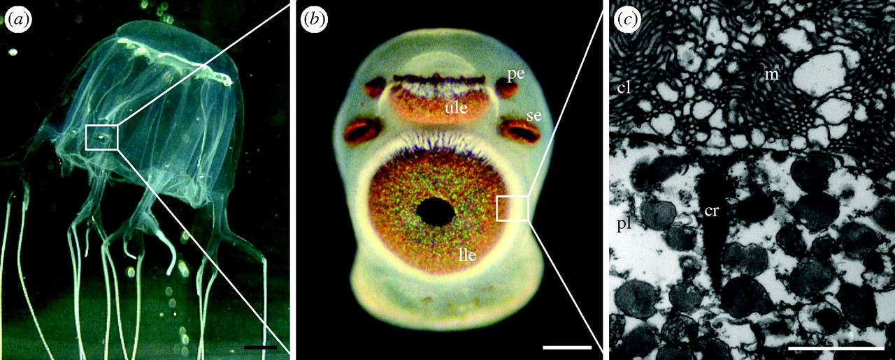
Refractive Cornea
The Box Jelly Fish

Slide 17
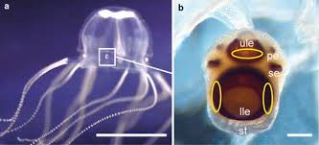
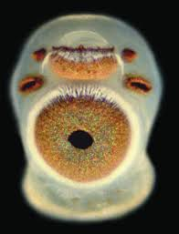
Refractive Cornea
The Box Jelly Fish

Slide 18
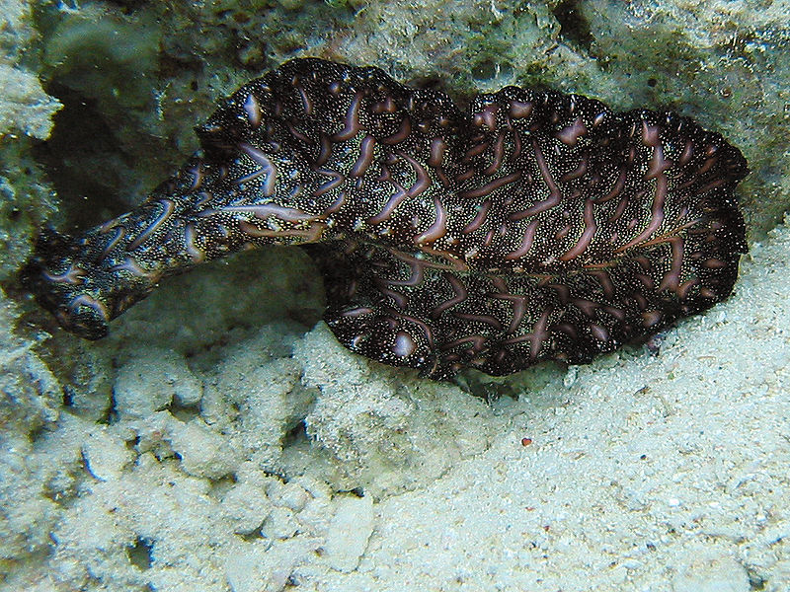
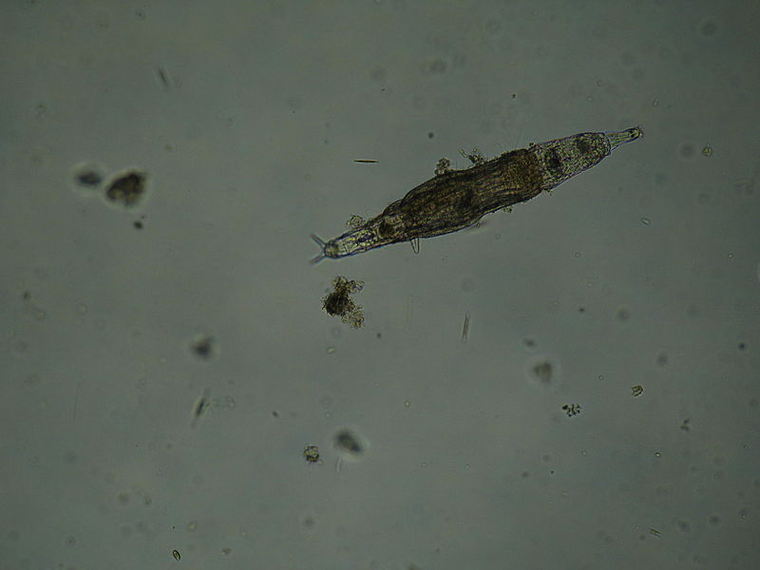
Reflector Eyes
Bedford's Flatworm
Rotifers

Slide 19
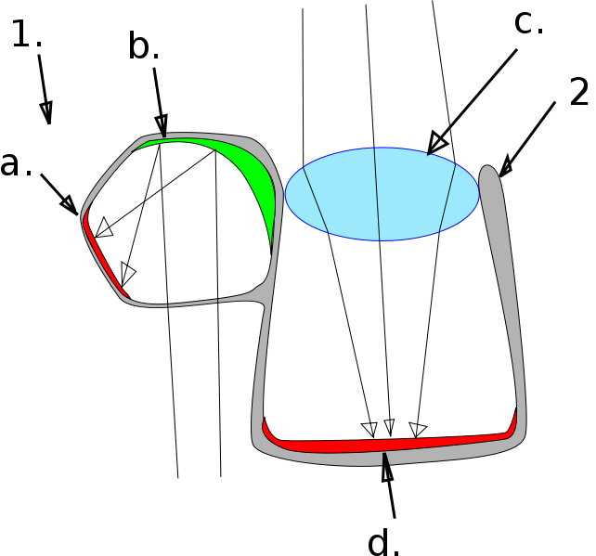
Reflector Eyes
Brownsnout Spookfish
The D. longipes eye.
(1) Diverticulum (a) Retina (b) Reflective crystals
(2) Main Eye (c) lens (d) retina

Slide 20
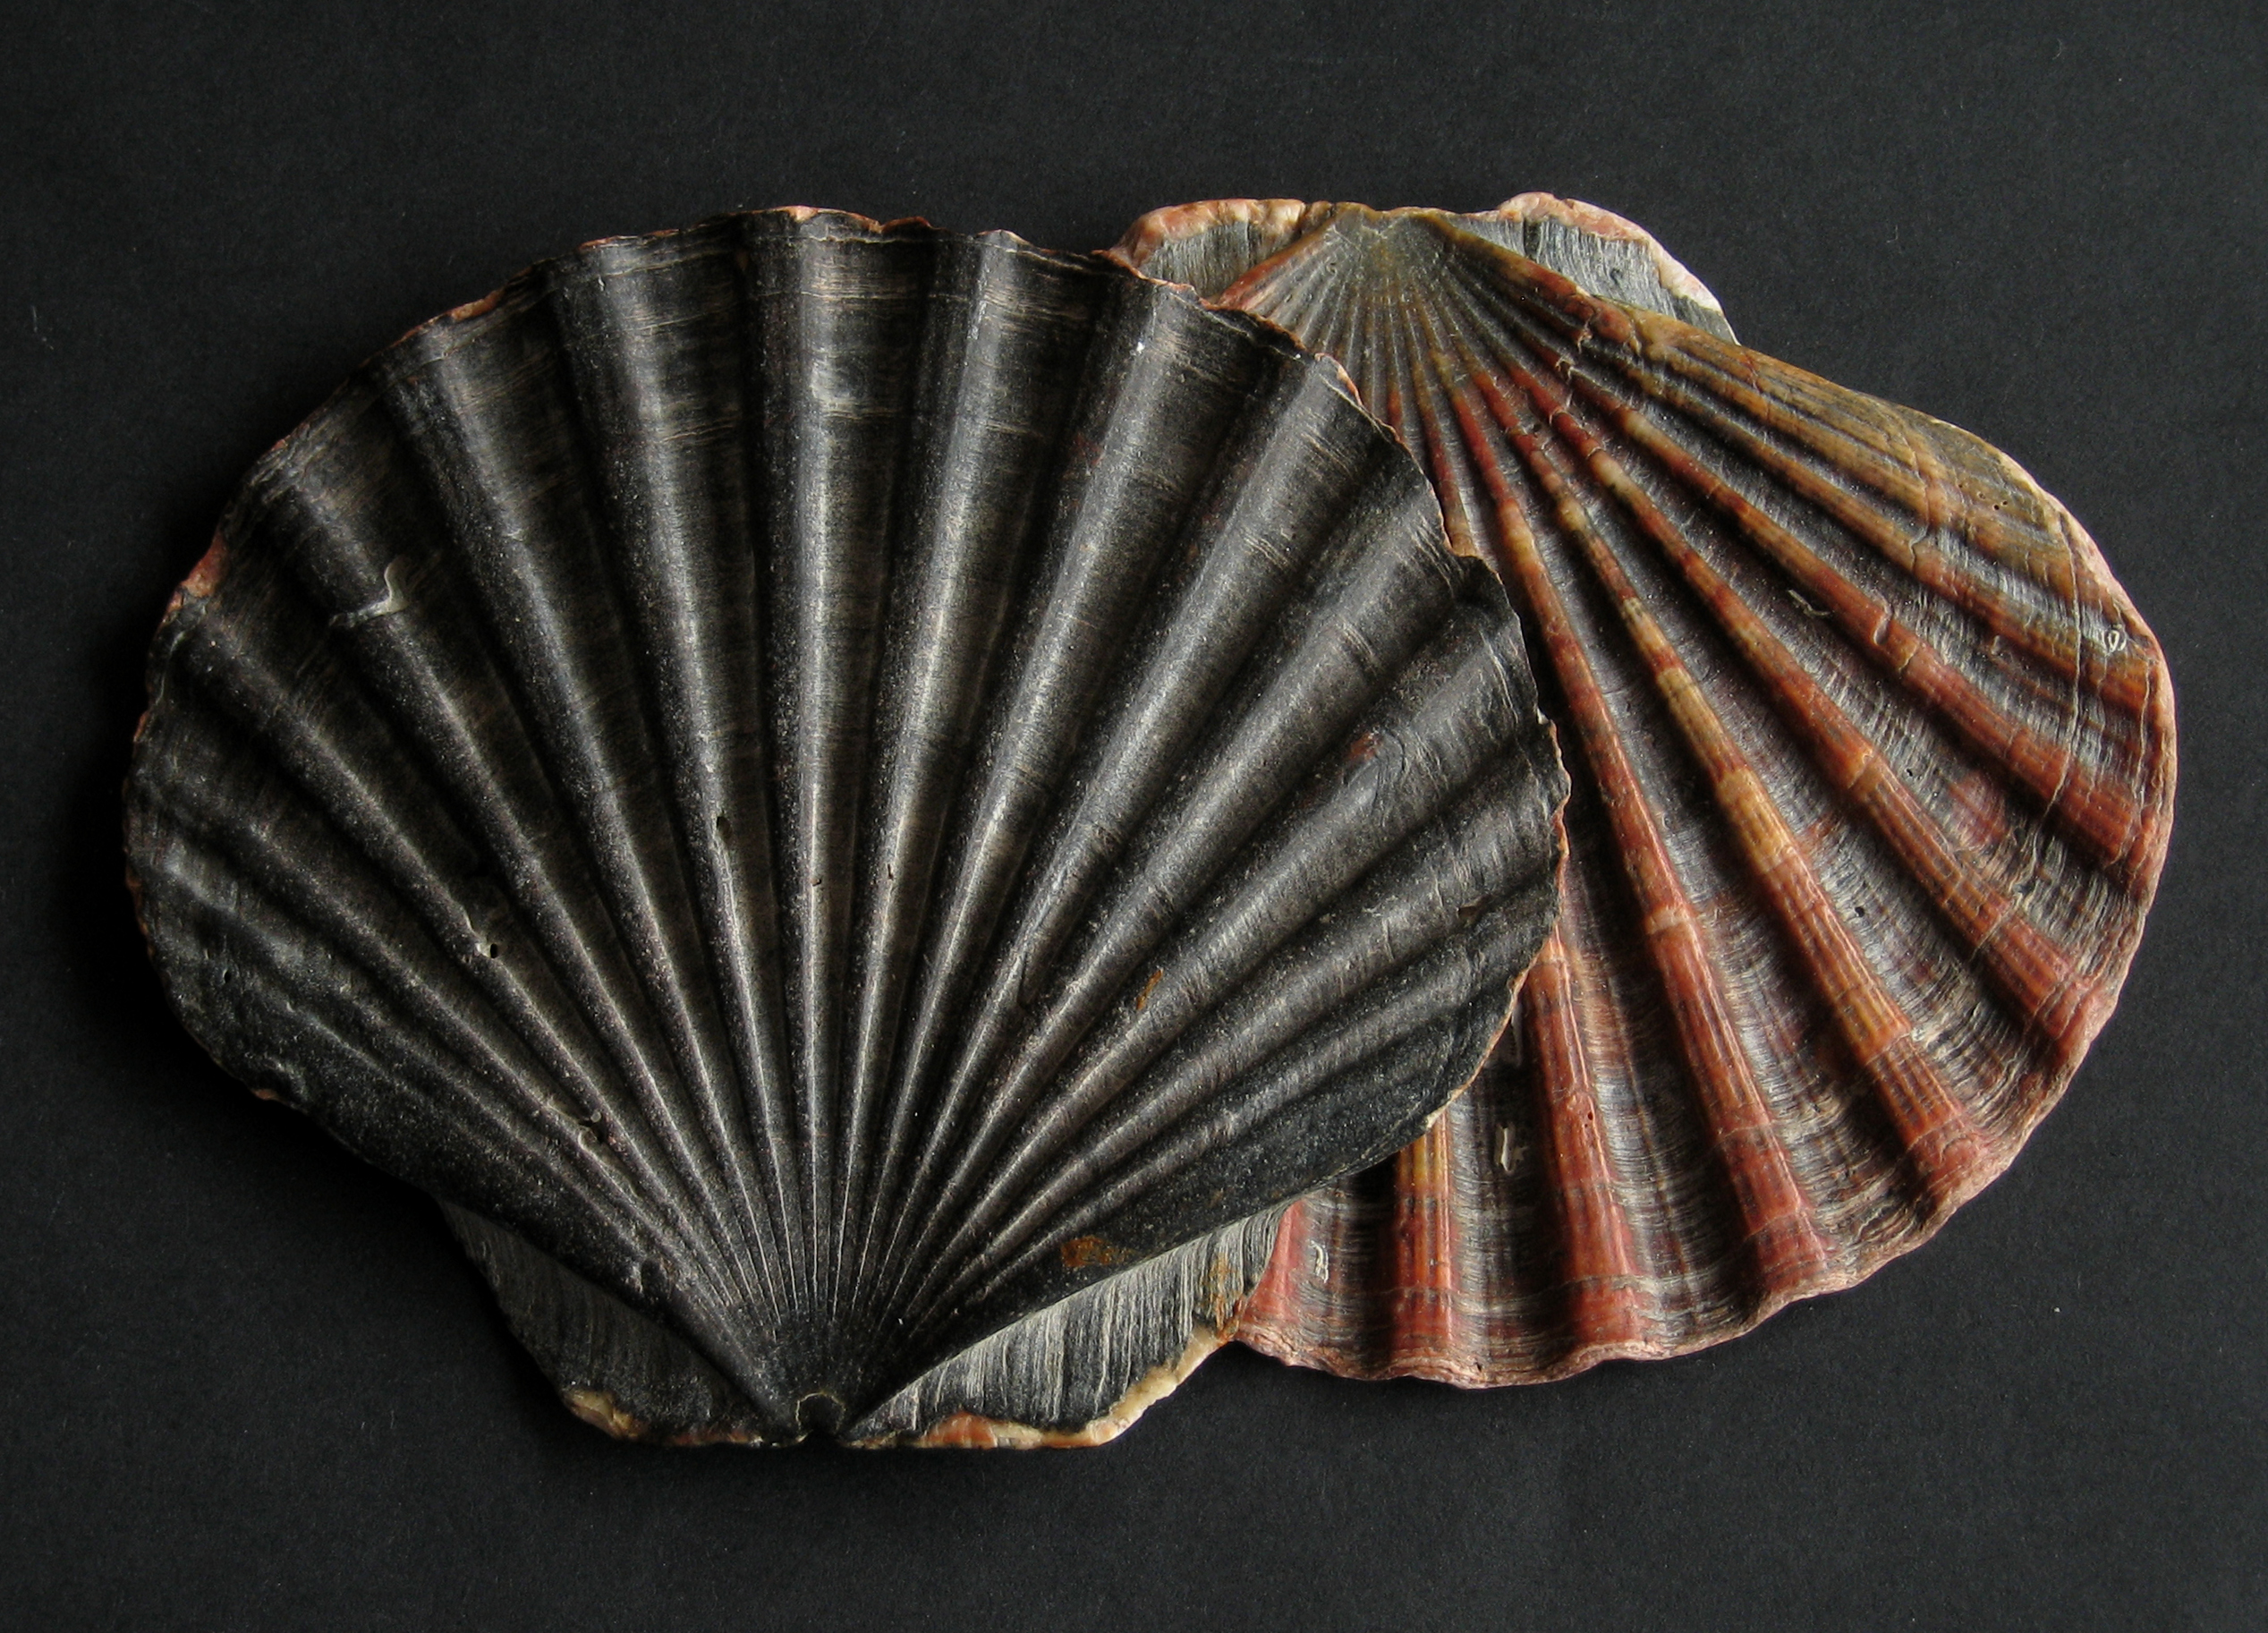
Reflector Eyes
The scallop Pecten

Slide 21
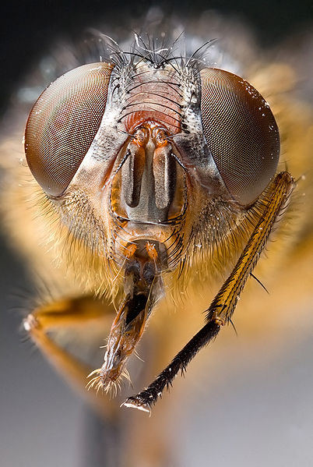
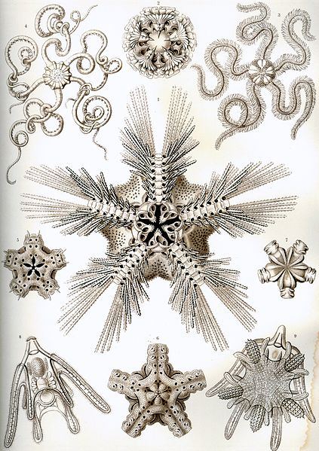
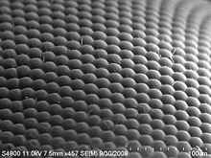
Compound Eyes
House Fly
Antarctic Krill
Star Fish
House Fly
Compound eyes fall into two groups: apposition eyes, which form multiple inverted images, and superposition eyes, which form a single erect image

Slide 22
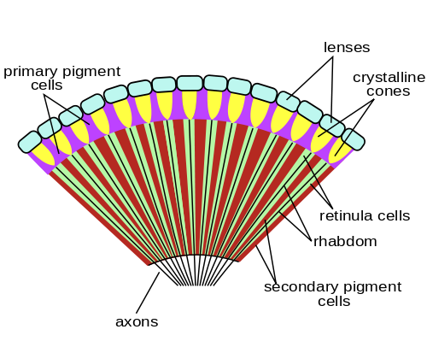
Apposition Compound Eyes
House Fly
The Horseshoe Crab
Some Annelids
Some Caterpillars
Apposition compound eyes, which form multiple inverted images.

Slide 23
Superposition Compound Eyes
The Mayfly
Nocturnal Insects
Lobsters, Crayfish
The refracting superposition eye
Parabolic superposition compound eye
Reflecting superposition eyes
Superposition compound eyes, which form a single erect image

Slide 24
Parabolic Superposition Compound Eyes
House Fly
Antarctic Krill
Star Fish
House Fly
Compound eyes fall into two groups: apposition eyes, which form multiple inverted images, and superposition eyes, which form a single erect image

Slide 25
Homoplasy In The Evolution Of Various Eyes
Non-Compound Eyes | Species
Pit eyes | Jelly Fish
 | Star Fish
 | Flatworms
 | Snails
 | Slugs
 | Gastropod Mollusks
 | Giant clams
 | Spiders
 | Bees
 | Grasshoppers
Spherical lensed eye | Gastropods
 | Copepods
 | Annelids
 | Cephalopods
 | Chitons
Multiple lenses | Pontella
 | Copilia
Refractive cornea | Mammals
 | Birds
 | Reptiles
 | Box Jelly Fish
Reflector eyes | Rotifers
 | Copepods
 | Platyhelminths
 | Scallop Pecten
 | The Spookfish
Compound Eyes | Species
Apposition eyes | Insects
 | Annelids
 | Bivalves
 | Horseshoe Crab
 | Caterpillars
Parabolic Superposition | Mayflies
 | Shrimp
 | Prawns
 | Crayfish
 | Lobsters
Compund Psuedo Pupil | Praying Mantis
 | Dragon Flies
Compound Ocelli | Scutigera
Refracting Superposition | Decapoda
 | Euphausiacea
 | Mysida

Slide 26
Phylum In The Evolution Of Various Eyes
Phylum | Meaning | Common name | Eyes | Species
Chaetognatha | Longhair jaw | Arrow worms | Compound Eyes | 100
Tardigrada | Slow step | Water bears | Compound Eyes | 1,000
Echinodermata | Spiny skin | Echinoderms | Ocelli | 7,000
Entoprocta | Inside anus | Goblet worm | Ocelli | 150
Gastrotricha | Hair stomach | Meiofauna | Ocelli | 690
Kinorhyncha | Motion snout | Mud dragons | Ocelli | 150
Mollusca | Soft | Mollusks | Ocelli | 112,000
Nematoda | Thread like | Round worms | Ocelli | 100,000
Nemertea | A sea nymph | Ribbon worms | Ocelli | 1,200
Onychophora | Claw bearer | Velvet worms | Ocelli | 200
Platyhelminthes | Flat worms | Flat worms | Ocelli | 25,000
Rotifera | Wheel bearer | Rotifers | Ocelli | 2,000
Sipuncula | Small tube | Peanut worms | Ocelli | 250
Annelida | Little ring | Segmented worms | Ocelli, Compound Eyes | 17,000
Arthropoda | Jointed foot | Arthropods | Ocelli, Compound Eyes | 1,134,000
Cnidaria | Stinging nettle | Coelenterates | Ocelli, Single Lense | 11,000
Chordata | With a cord | Chordates | Single Lense | 100,000

Slide 27
Pseudo Pupil Gives Acute Vision
Dragonflies
Praying Mantis

Slide 28
Mysida Shrimp
The shrimp has an eye of the type, in the rear behind this in each eye there is a single large facet that is three times in diameter the others in the eye and behind this is an enlarged crystalline cone. This projects an upright image on a specialised retina. The resulting eye is a mixture of a simple eye within a compound eye.

Slide 29
Scutigera coleoptrata
This type of eye consists of a cluster of numerous ocelli on each side of the head, organised in a way that resembles a true compound eye.

Slide 30
Sea Urchins
The tube feet of sea urchins contain photoreceptor proteins, which together act as a compound eye.

